Slide 1
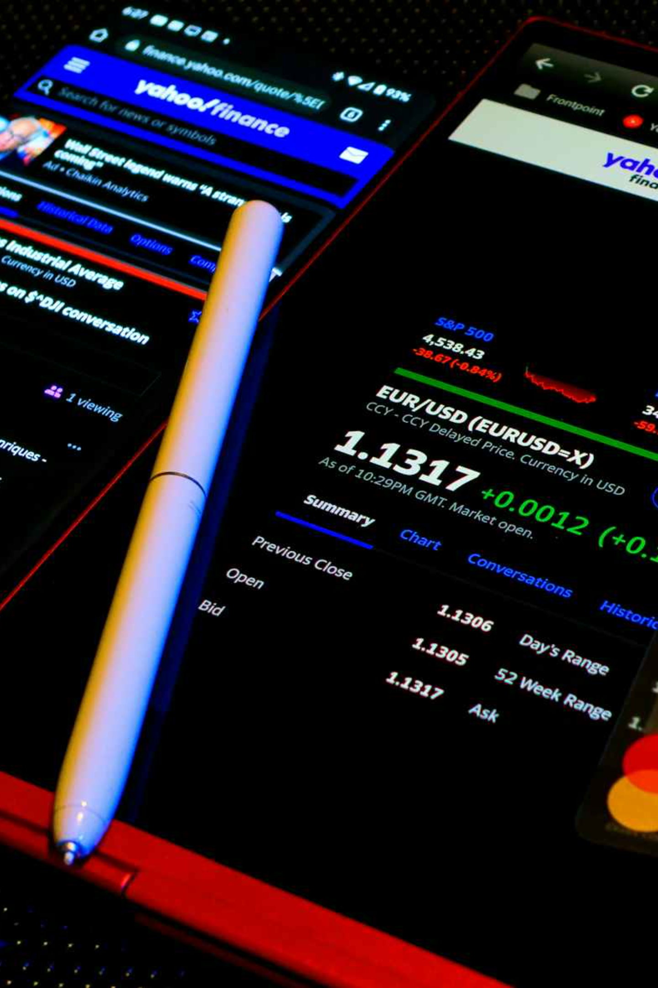

GL INTERFACE APPLICATION
David Ocholi
Business Analyst
September 2025

Slide 2

Statement of Work Overview
Client A currently uses SICS and SunSystems (“Sun”) General Ledger software. There is a manual export of SICS GL data and import into Sun on a quarterly basis.
This project is to implement a GL Interface Application which extracts new GL data from SICS automatically on a schedule (assumed to be daily) and then connects and uploads this data in the required format to Sun using Sun’s API functionality.
It will also provide sufficient automatic reconciliation features to ensure that the two systems are in alignment. This should reduce the amount of effort required by Client A to pass GL data to Sun and improve the efficiency of their period-end closing process. It will also make the mapping and transformation of data from SICS to Sun format more visible and maintainable by the users.

Slide 3





Analysis Synopsis
The current (“As-Is”) process is manual, quarterly, and resource-intensive, with heavy user involvement in extraction, transformation, and reconciliation.
The proposed (“To-Be”) process introduces a GL Interface Application that automates extraction, transformation, loading, and reconciliation. This proposed system will:
Streamline Transfer
Increase Frequency
Automate GL data movement between systems
Daily updates instead of quarterly
Improve Accuracy
Enhance Visibility
Automated reconciliation reduces errors
Clear mapping and maintainable processes

Slide 4
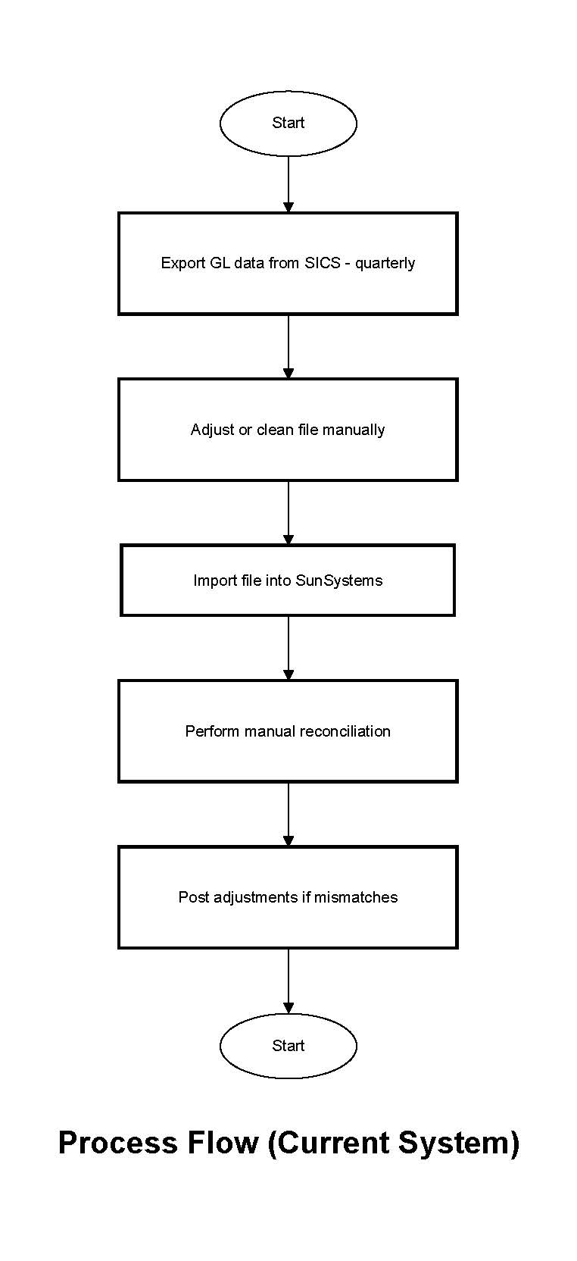
Process Workflows (Current)
Current System
The flowchart illustrates the existing process, which is largely manual and conducted on a quarterly basis. GL data is exported from SICS, then manually transformed into the required format before being uploaded into Sun. This approach is time-consuming, prone to human error, and places a significant burden on the Finance team during period-end closing.

Slide 5


Current Manual System (As-Is)
The existing quarterly processing system requires significant manual intervention and creates bottlenecks in financial operations and reporting.
Processing Frequency
Manual Effort
Error Rate
Quarterly operations
2–3 Full-Time Equivalent (FTE)
days per quarter spent on extraction,
transformation, reconciliation and
reporting.
5–10% manual reconciliation
≈ 4 times per year
Adjustments required
Closing Cycle Impact
Limited Visibility
Adds 2–3 days of effort to each quarter-end closing, creating delays in financial reporting and decision-making processes.
Lack of transparency into how data is transformed and mapped, making it difficult to track changes and ensure accuracy.

Slide 6
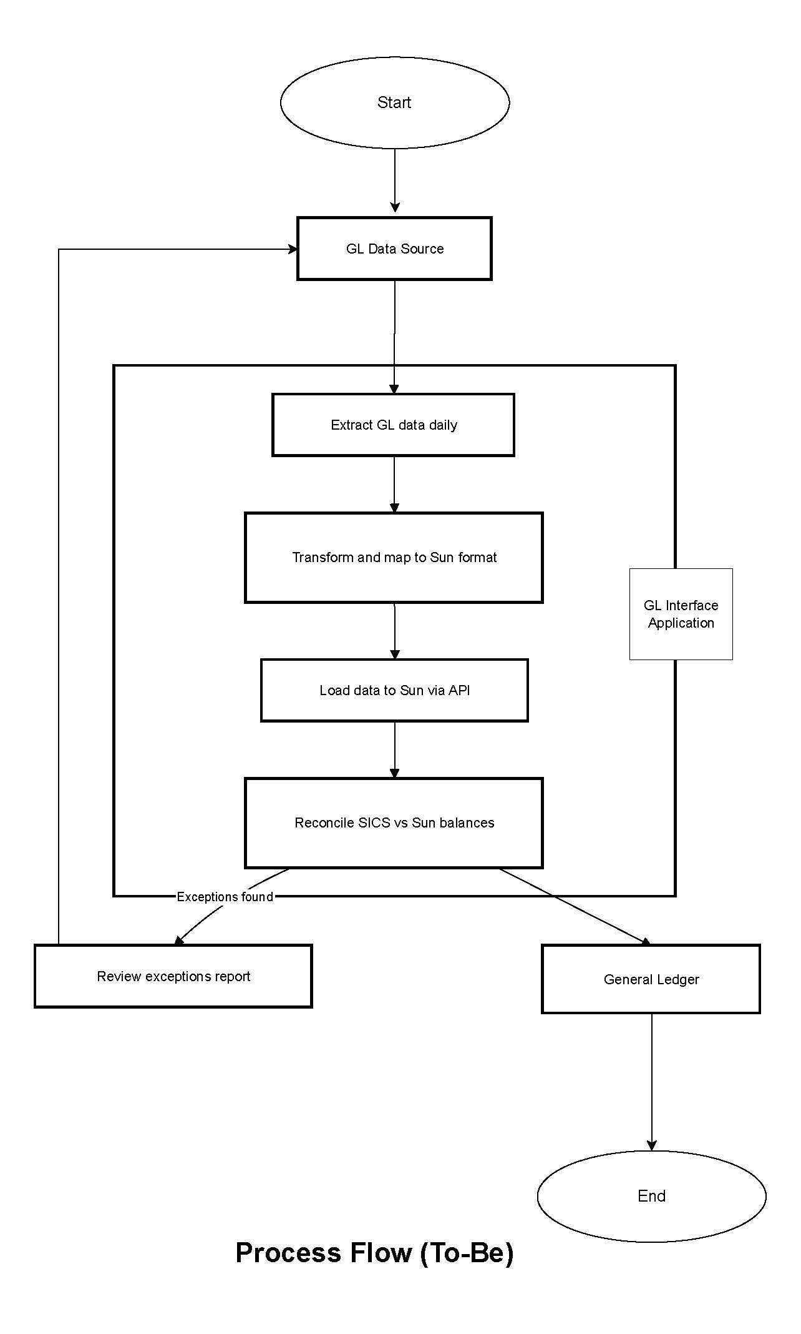
Process Workflows (Proposed)
Proposed System
The diagram outlines the proposed automated process supported by the GL Interface Application. In this design, GL data is automatically extracted from SICS on a daily schedule, transformed into the Sun-compatible format, and uploaded via API. Built-in reconciliation and exception handling ensure accuracy and transparency, while reducing manual effort and enabling faster, more efficient period-end closing.

Slide 7


Proposed Automated System (To-Be)
Transform operations in 24 hours with automated processing that delivers exceptional accuracy and transparency.
Daily Processing
Minimal Manual Effort
Superior Accuracy
≈ 240 runs per year
< 0.5 FTE days per month
< 1% error rate
Continuous data processing eliminates quarterly bottlenecks.
Only for reviewing exceptions and monitoring system performance.
Automated reconciliation and validation ensures data integrity.
Accelerated Closing
Enhanced Visibility
Saves 2–3 days per quarter-end closing, enabling faster financial reporting and improved decision-making timelines.
Configurable mapping and real-time dashboards provide complete transparency into data transformation processes and system performance.

Slide 8



Basic Functional Requirements
The table below outlines the key functional requirements that define what the GL Interface Application must do to deliver value.
Requirement | Description | Problem Addressed
Data Extraction | Automate GL data extraction from SICS on a scheduled basis (e.g., daily). | Manual extraction from SICS is time-consuming and only done quarterly.
Data Transformation | Convert extracted data into Sun format using configurable mapping rules. | Manual reformatting leads to errors and delays.
Data Loading | Load transformed data into Sun via API, supporting batch and incremental loads. | Manual uploads increase risk of mistakes and slow down reporting.
Reconciliation | Automatically reconcile SICS vs Sun balances and highlight discrepancies. | Discrepancies often go undetected until quarter-end, delaying close.
Exception Handling | Generate error logs and exception reports, enabling reprocessing after fixes. | No structured way to track or correct errors in the current process.
User Interface | Provide dashboards for monitoring status, managing mappings, and reviewing errors. | Current process lacks visibility, users can’t easily monitor progress or errors.
Audit & Security | Maintain audit logs, enforce role-based access, and ensure secure data transfer. | Manual processes have weak audit trails and data risks.
Automated Extraction
Smart Transformation
Seamless Loading
Scheduled daily data pulls from SICS system
Configurable mapping rules for format conversion
API-based uploads with batch and incremental support

Slide 9
Non-Functional Requirements
The table below highlights the non-functional requirements, which sets the quality standards and operational expectations for the solution.
Non-Functional Requirement | Description | Problem Addressed
Performance | The system should process and upload daily GL data within an acceptable time of < 30 min per run. | Manual quarterly uploads delay financial reporting and cause bottlenecks.
Reliability | The interface should run on a stable schedule with >99% success rate, minimizing failures. | Current manual approach is error-prone and inconsistent.
Maintainability | Transformation rules should be configurable by users without code changes. | Current data transformations require IT intervention, slowing updates.
Scalability | The solution should handle increasing data volumes (allowing growth of 2-3x) without performance loss. | Current system cannot easily adapt to higher transaction volumes.
Security | Data transfers must be encrypted (e.g., TLS/HTTPS), with strict role-based access controls. | Manual data handling increases risk of unauthorized access or data leakage.
Auditability | The system should maintain a full audit log of extractions, uploads, and reconciliation activities. | Current process has poor visibility into changes and approvals.
<30
99.9%
24/7
Minutes Max
Uptime Target
Monitoring
Processing time for daily GL operations
System availability during business hours
Continuous system health tracking

Slide 10
Potential Risks & Mitigation Strategies
The risks outlined below identify potential challenges that could impact the success of the project, along with their implications and mitigation strategies.
Risk | Description | Mitigation Strategy
Integration Risk | APIs or integration points in SICS or Sun may have limitations or undocumented behaviors, leading to extra development effort and workarounds. | Conduct early technical due diligence on APIs, engage with vendor support, and build flexible integration logic with error handling and logging.
Data Quality Risk | Poor or inconsistent SICS data may cause reconciliation mismatches and incorrect postings in Sun. | Implement data validation rules at extraction, introduce automated data cleansing, and involve business users in periodic data quality reviews.
Dependency Risk | Reliance on vendor timelines (for Sun or SICS upgrades, fixes, or documentation) could delay project progress. | Build contingency time into project plan, establish vendor SLAs, and prioritize early identification of dependencies in the project schedule.
Change Management Risk | Users may resist moving from manual to automated processes, risking adoption and efficiency gains. | Conduct stakeholder engagement, provide comprehensive training, and implement phased adoption with dual-running of old and new processes initially.
Operational Risk | Failures in reconciliation or unnoticed errors could compromise financial reporting accuracy. | Set up automated monitoring, alerts, and dashboards; enforce segregation of duties for reconciliation checks; and establish escalation protocols.
Timeline Risk | Delays in requirements gathering or scope changes may extend project delivery timelines. | Define and agree clear scope upfront, use phased/milestone-based delivery, and apply strong change control processes.

Slide 11
Key Questions (First Two Weeks)
The following key questions will guide discovery in the first two weeks, ensuring clarity on scope, design, and implementation.
To ascertain the scope and volume of the data, what is the average and peak GL transaction volume expected daily?
To clarify integration requirements, what file formats and API specifications are available for both SICS and Sun?
To define the reconciliation process, what specific reconciliation rules should be applied (for example, should it be by account, totals, or both)?
To establish ownership of mapping, who will be responsible for maintaining and updating account mappings, will it be Finance or IT?
To determine the exception management approach, how should exceptions be reported (e.g., dashboard alerts/notifications, automated emails)?
To meet security standards, what encryption protocols and access control policies must the application comply with?
To align on timelines and meet up with deadlines, by what time each day must GL data be fully processed and updated in Sun?
To anticipate dependencies, are there any upcoming system upgrades or changes to SICS/Sun that could impact the integration?

Slide 12
Conclusion
The implementation of the GL Interface Application will significantly improve efficiency, accuracy, and transparency in Client A’s financial closing process. With clear functional and non-functional requirements, expanded risk considerations, and well-defined key questions, the project can be delivered with minimal disruption while providing high long-term value.

Slide 13
Thank You

